Slide 1
First Steps in R
Understanding Data Analysis and Visualization

Slide 2
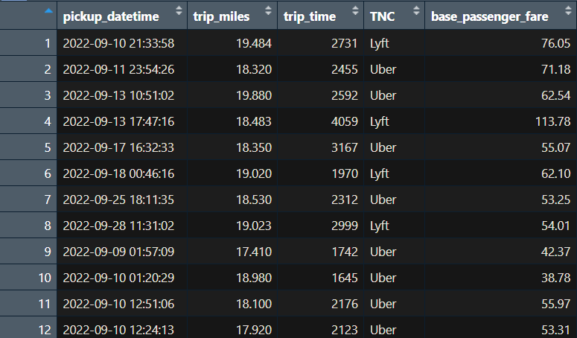
What is a DataFrame?
Tabular form of storing data
Each row is an observation or datapoint
Each column is a variable or attribute

Slide 3
What is R good at?
R makes working with dataframes incredibly easy
(In my opinion) if your project primarily involves cleaning, manipulating, and visualizing dataframes, R is probably the best tool for the job
“Piping” allows rapid prototyping

Slide 4
Usual operations on a DF
(Filtering) Cleaning your data: conditionally removing rows
(Mutate) Add more columns to your data
(Merge) Combining two DF based on some variables
(Group & Summarize) Aggregate your data

Slide 5
Setting up R and RStudio
Download R from : https://cran.r-project.org/
R is the programming language
Download RStudio from: https://posit.co/downloads/
RStudio is the IDE that works best with R

Slide 6
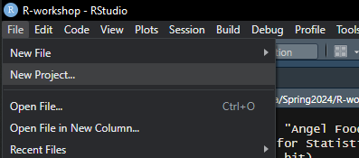
Starting a project
New folder to store your data
Open RStudio
File > New Project > Existing Directory…and browse to your folder
getwd()
File > New File > R Script

Slide 7
install.packages(“tidyverse”)
tidyverse : is a collection of packages
dplyr : manipulating data frames
ggplot : make plots
lubridate : work with dates
library(tidyverse)
Notes:
These packages will do the heavy lifting. We will install/load other packages as needed.

Slide 8
Reading and Exploring your Data
load your data: df = read.csv(…)
get column names: names(df)
Select columns: df = df %>% select(col1, col2, …)
Get summary: df %>% summary()

Slide 9
Piping %>%
Ctrl + shift + m
df %>% f() applies the function f to dataframe df
Allows you to manipulate data without having to save intermediate steps
Very powerful when you’re playing with your data

Slide 10
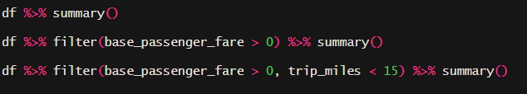
Filtering
Removes all rows satisfying a given condition

Slide 11
Mutate
Rename base_passenger_fare to fare: rename(old_name = new_name)
Calculate fare/trip_miles and add it as a new column: mutate(…)
Add a column for hour of day
Use factor to convert a numerical column to a category column
Remove all rows where fare_per_mile > 15

Slide 12
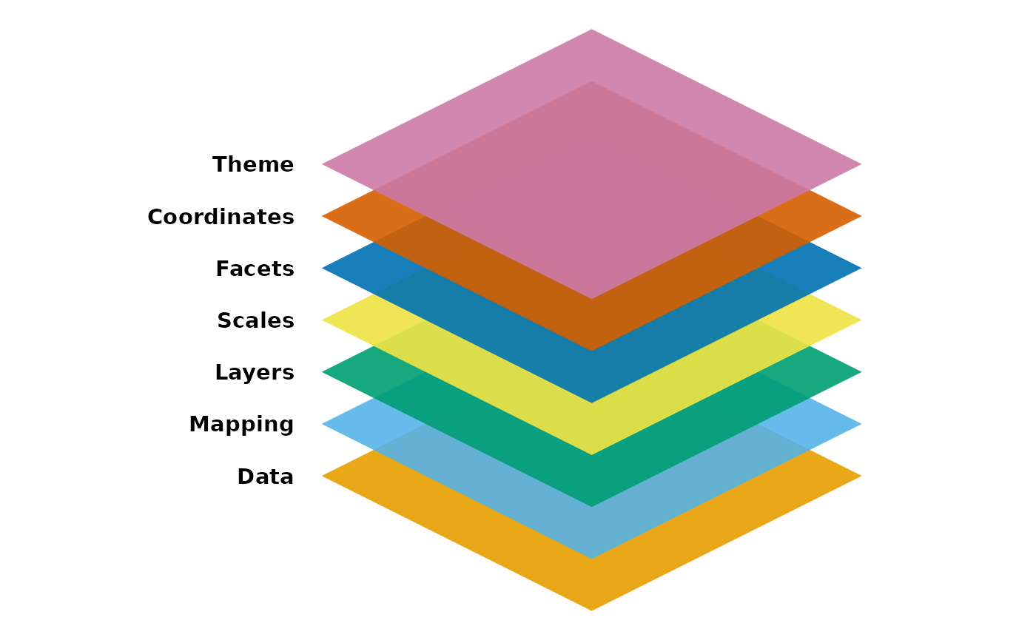
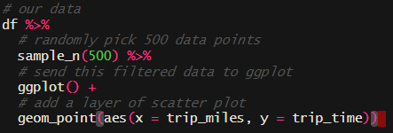
Plotting
Use ggplot: see https://ggplot2.tidyverse.org/articles/ggplot2.html
Plots are collection of layers: different functions to add different types of layers
Use + to combine layers
aes(…) defines the aesthetics of a layer: variables to assign to x and y; can also define color, size and alpha (transparency)
Notes:
Add color for fare

Slide 13
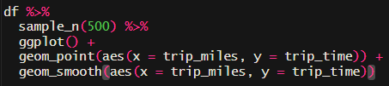
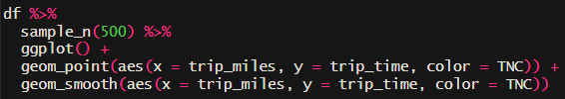
Plotting – adding trendline
geom_smooth(aes(…))
Use aes(…, color = TNC) and see what happens
You can add different layers and variables to aes(…) according to your needs

Slide 14
Plotting – distribution
Similar geom_density will create density plots
No need to subset data
+ geom_density(aes(x = fare)) to see distribution
+ xlim(0, 100) to set reasonable bounds
How to check if fare is distributed similarly for Uber and Lyft?
Try geom_violin(x = TNC, y = …)
Notes:
What other plots do you use?

Slide 15

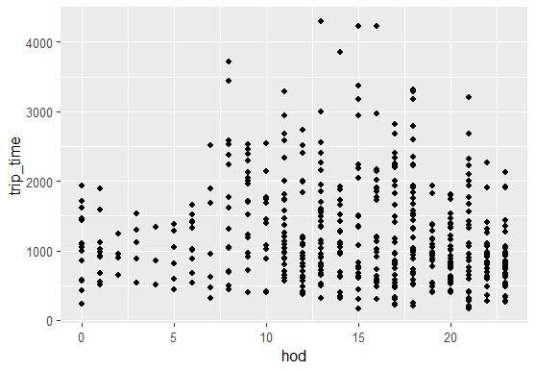
Working with datetime data: lubridate
Commands like hour(), day(), month(), year()…..
How does trip_time depend on hour of day?
Create a column hod = hour(pickup_datetime)
+geom_point(x = hod, y = trip_time)
Notes:
Doesn’t tell me much. What if I could find averages for each hour?

Slide 16
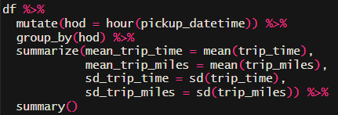
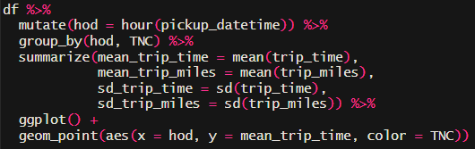
group_by(…) %>% summarize(…)
Allows us to group data based on different columns
Can find summary statistics for those groups
Outputs a new data frame with the aggregated data
Use the aggregated dataframe to make plots, etc.
Use group_by(hod, TNC) to get it separately for each TNC
Notes:
What if I want for each hour of one day at a time?

Slide 17
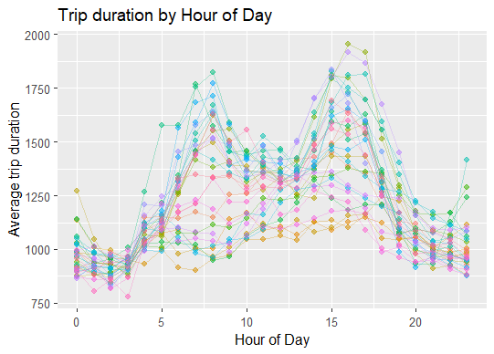
Challenge
hour of day on x-axis
Average trip time for each hour of each day on y-axis
Add a line connecting observations from the same day
Change labels on x-,y-axis using +xlab(…)+ylab(…)
Use ggtitle(…) to add a title

Slide 18

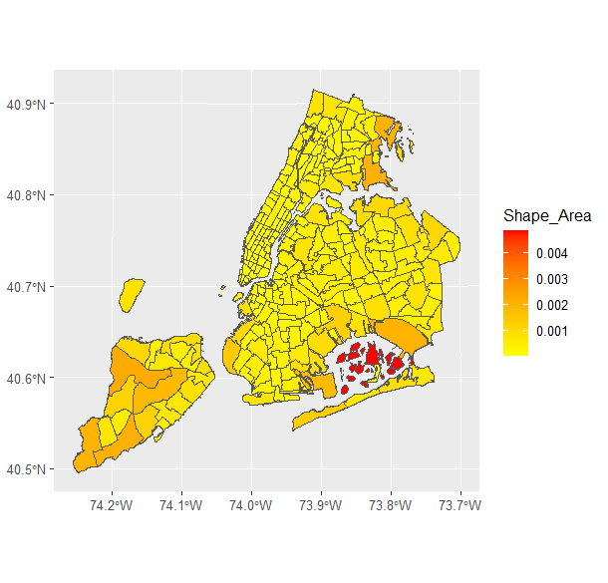
Spatial data
library(sf) : working with spatial data
shpf = read_sf(…)
names(shpf) to see the columns
+geom_sf(aes(fill = …)) to plot
Google scale_fill_continuous() ggplot to have fun with the legend
Notes:
We can do a lot of different changing the

Slide 19
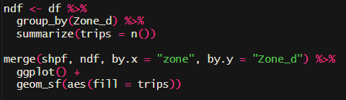
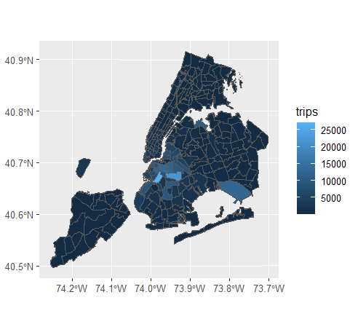
Merging DataFrames
We want to calculate the number of trips going to different Zone_d : group_by(Zone_d) and create a new df
To map, we need to merge it with shpf
Figure out which columns correspond to zones in the two dataframes
Use merge(df1, df2, by.x = col1, by.y = col2)
df1 should be the spatial dataframe
Notes:
We can do a lot of different changing the

Slide 20
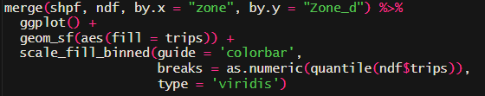
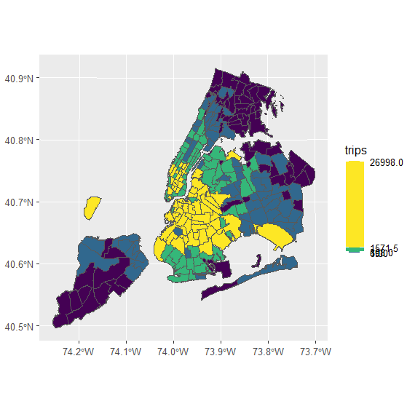
Other layers in ggplot
The map doesn’t look that great
Legend is one of the most important layer of the map
Customize it with +scale_fill…..
Not enough variation in data
Bin my datapoints by the quantile they fall in
Notes:
We can do a lot of different changing the

Slide 21
Conclusion
Most data analysis tasks are combinations of filtering, manipulating, and grouping and summarizing
Working with your data involves performing these tasks serially
Piping these results into plots allows you to see the results of your actions very quickly allowing fast prototyping
It takes time to learn a language. Practice and have fun working with your data!

Slide 22

Thank you
Feedback please -_-
https://go.cee.illinois.edu/ASCETDI_Survey

